Slide 1



Presented By:
Abhar Team
Abbhar.ssip@gmail.com

Slide 2


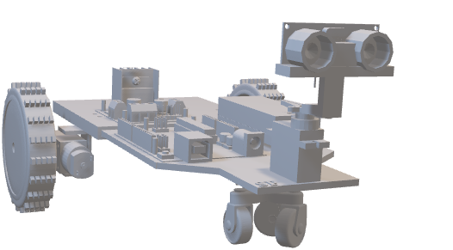
Table Of Content
Content List
01.
03.
05.
Who We Are
Progress Till now
Portfolio
02.
04.
06.
Vision & Mission
Our Product
Contact Us

Slide 3

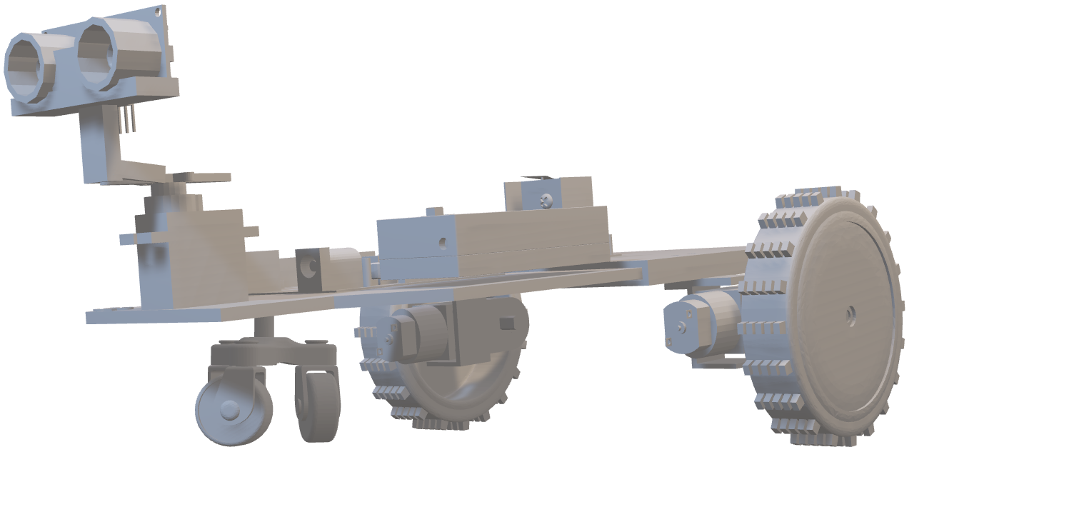
About Us
Who We Are
we are passionate about revolutionizing the way people interact with their homes. With a dedicated team of innovators, engineers, and designers, we are committed to creating cutting-edge solutions that seamlessly integrate AI, robotics, and IoT to enhance home security and automation.
Using the espHome
Server & Cloud based System
Home
Assistances

Slide 4



The Team Behind Us
Teamwork Is The Key
Saurabh Singh
Poojan Mehta
Leader
Web and Cloud

Slide 5



The Team Behind Us
Teamwork Is The Key
Ashish Bind
Abdullah Chaudry
Darshan Prajapati
IoT
Report & Doc
Designing

Slide 6




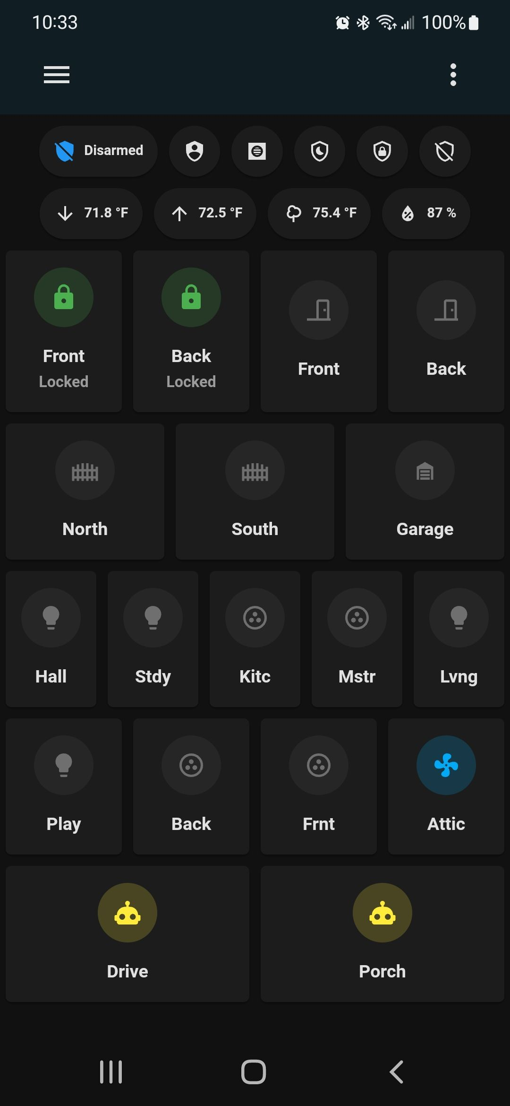


Home Assistance
App
A home assistance app is a mobile application designed to help homeowners manage various aspects of their home environment, from security and automation to everyday tasks and routines. These apps typically leverage smart home technology and Internet of Things (IoT) devices to provide users with remote control and monitoring capabilities for their home systems.
App Interface
Speed

Slide 7
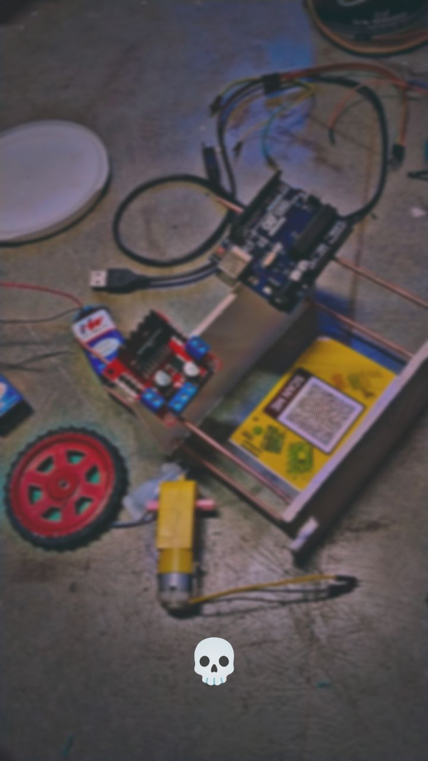
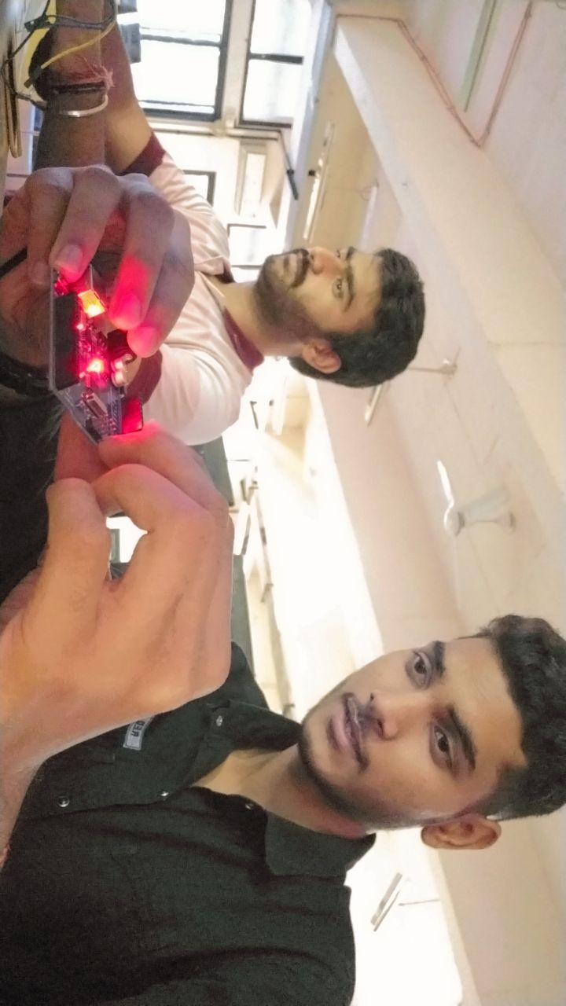
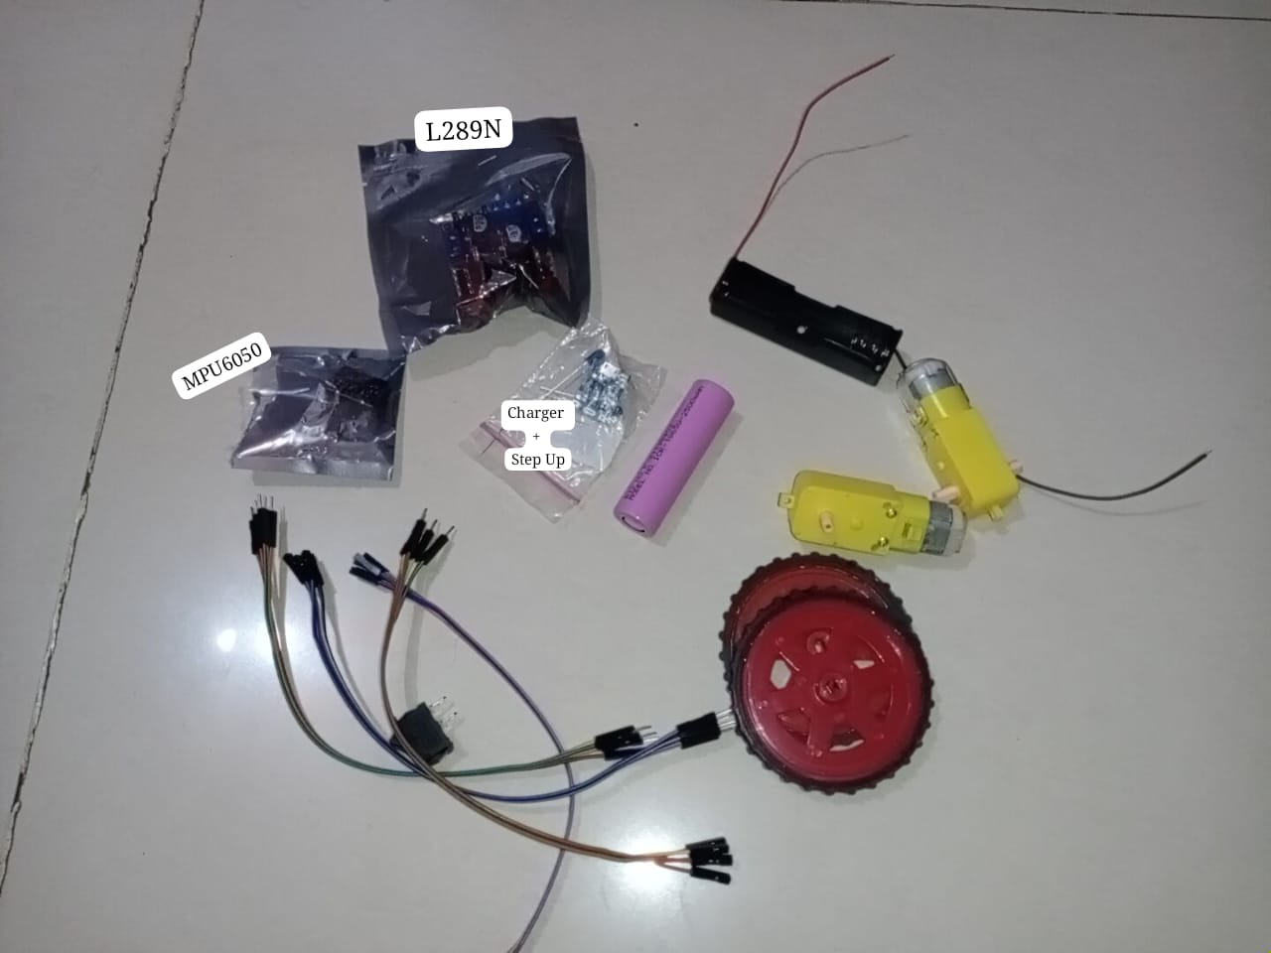
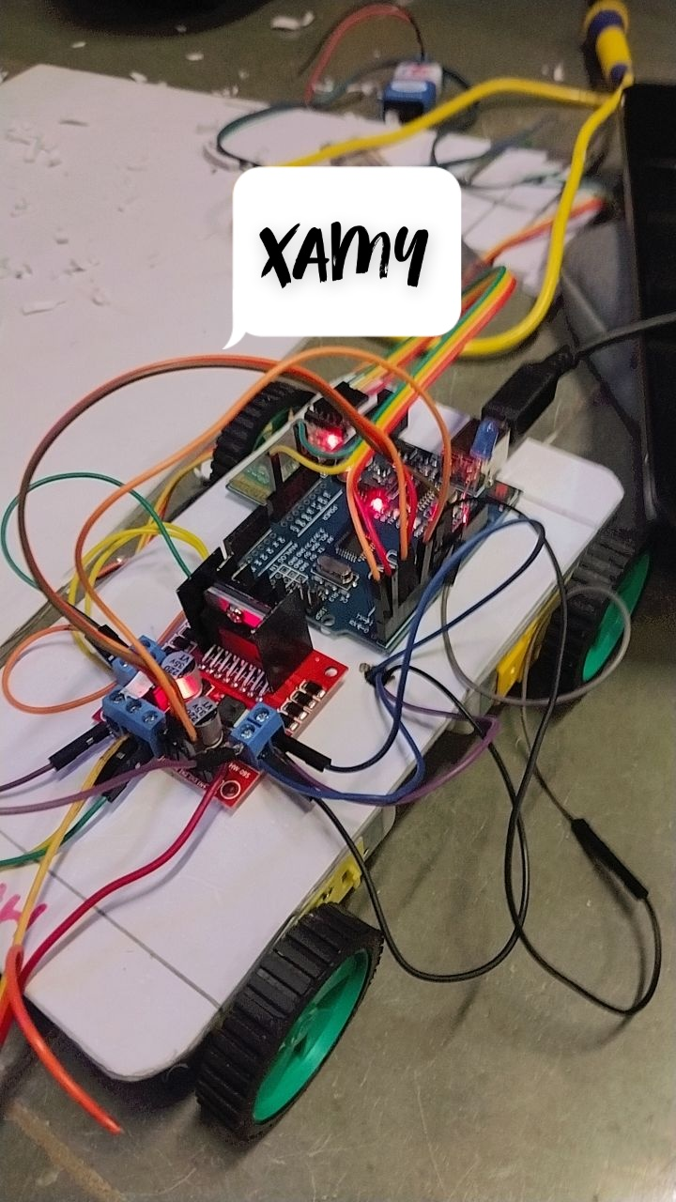
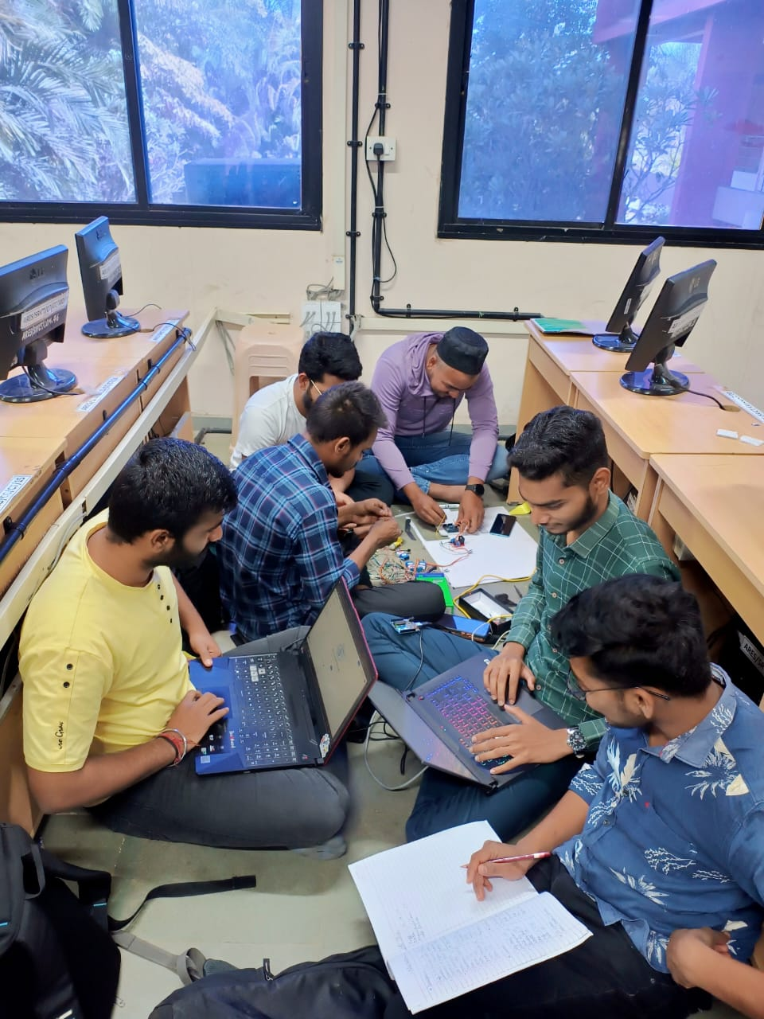
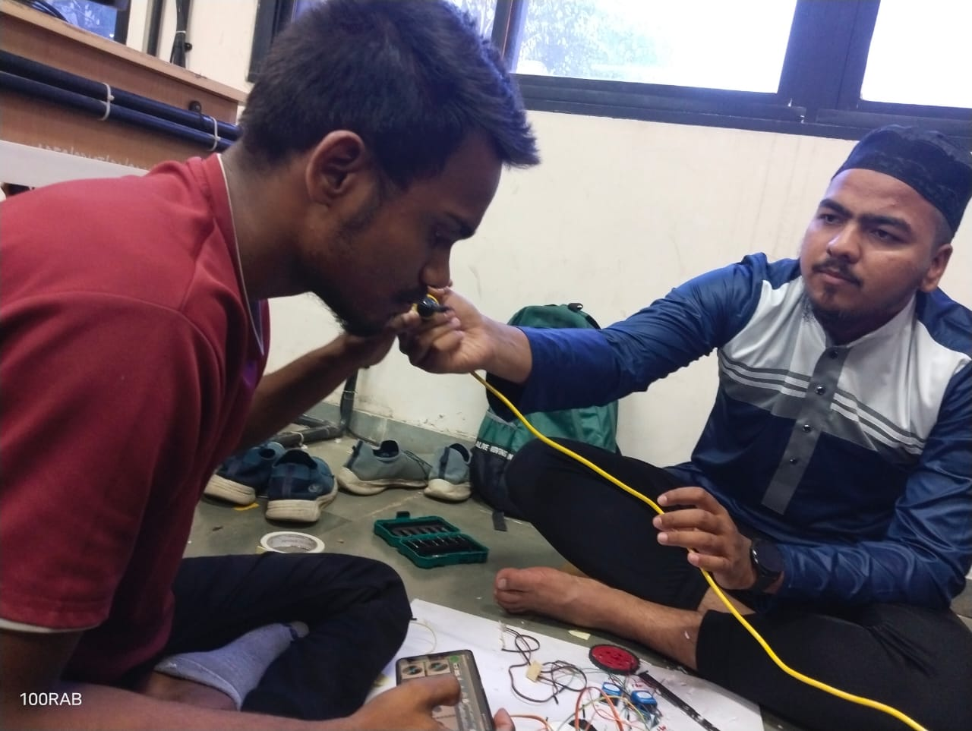
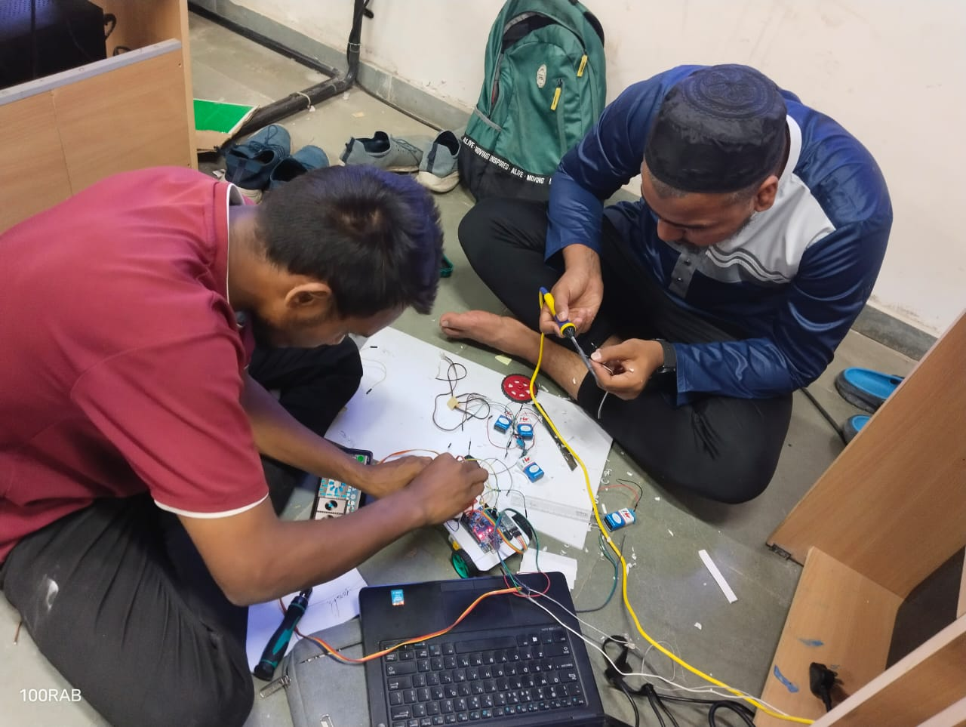
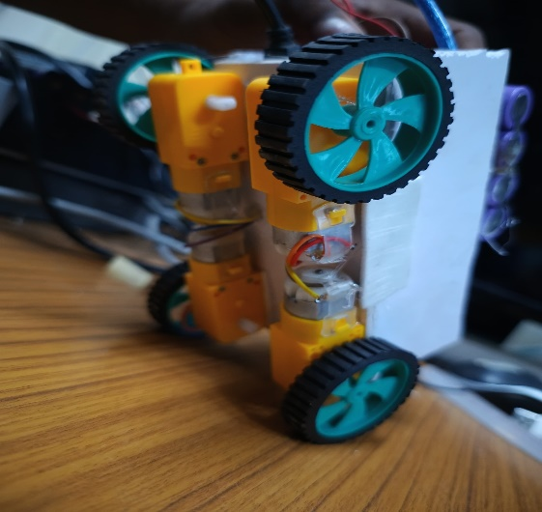
ROBO FORMATION
PHASE-1
Our Picture

Slide 8
Great Price List
Offer For You
$20
$50
$60
BRONZE
SILVER
GOLD
Gain knowledge
More services
Faster process
Guaranteed safety
Gain knowledge
More services
Faster process
Guaranteed safety
Gain knowledge
More services
Faster process
Guaranteed safety

Slide 9



22/04/2023
THANKS
Follow Us On Social Media
@reallygreatsite

